Slide 1
Computer Systems for Data Science Topic 5
Adapted from Database System Concepts, 7th edition, Silberschatz, Korth and Sudarshan
Distributed File Systems
Distributed Databases
Two Phase Commit

Slide 2
Partitioning and Replication

Slide 3
Introduction
Data storage needs are growing increasingly large
user data at web-scale
100’s of millions of users, petabytes of data
transaction data are collected and stored for analysis.
multimedia objects like images/videos
Parallel storage system requirements
storing large volumes of data
processing time-consuming decision-support queries
providing high throughput for transaction processing
Very high demands on scalability and availability

Slide 4
Parallel/Distributed Data Storage History
1980/1990s
Distributed database systems with tens of nodes
2000s:
Distributed file systems with 1000s of nodes
Millions of Large objects (100’s of megabytes)
Web logs, images, videos, …
Typically create/append only
Distributed data storage systems with 1000s of nodes
Billions to trillions of smaller (kilobyte to megabyte) objects
Social media posts, email, online purchases, …
Inserts, updates, deletes
Key-value stores
2010s: Distributed database systems with 1000s of nodes

Slide 5
Storage Parallelism
Reduce the time required to retrieve data from disk by partitioning the relations on multiple disks, on multiple nodes (computers)
Our description focuses on parallelism across nodes
Same techniques can be used across disks on a node
Horizontal partitioning – tuples of a relation are divided among many nodes such that some subset of relation resides on each node.
Contrast with vertical partitioning, e.g. r(A,B,C,D) with primary key A into r1(A,B) and r2(A,C,D)

Slide 6
Storage Parallelism
Partitioning techniques (number of nodes = n):
Round-robin:
Send the i^{th} tuple inserted in the relation to node i mod n.
Hash partitioning:
Choose one or more attributes as the partitioning attributes.
Choose hash function h with range 0…n - 1
Let i denote result of hash function h applied to the partitioning attribute value of a tuple. Send tuple to node i.

Slide 7
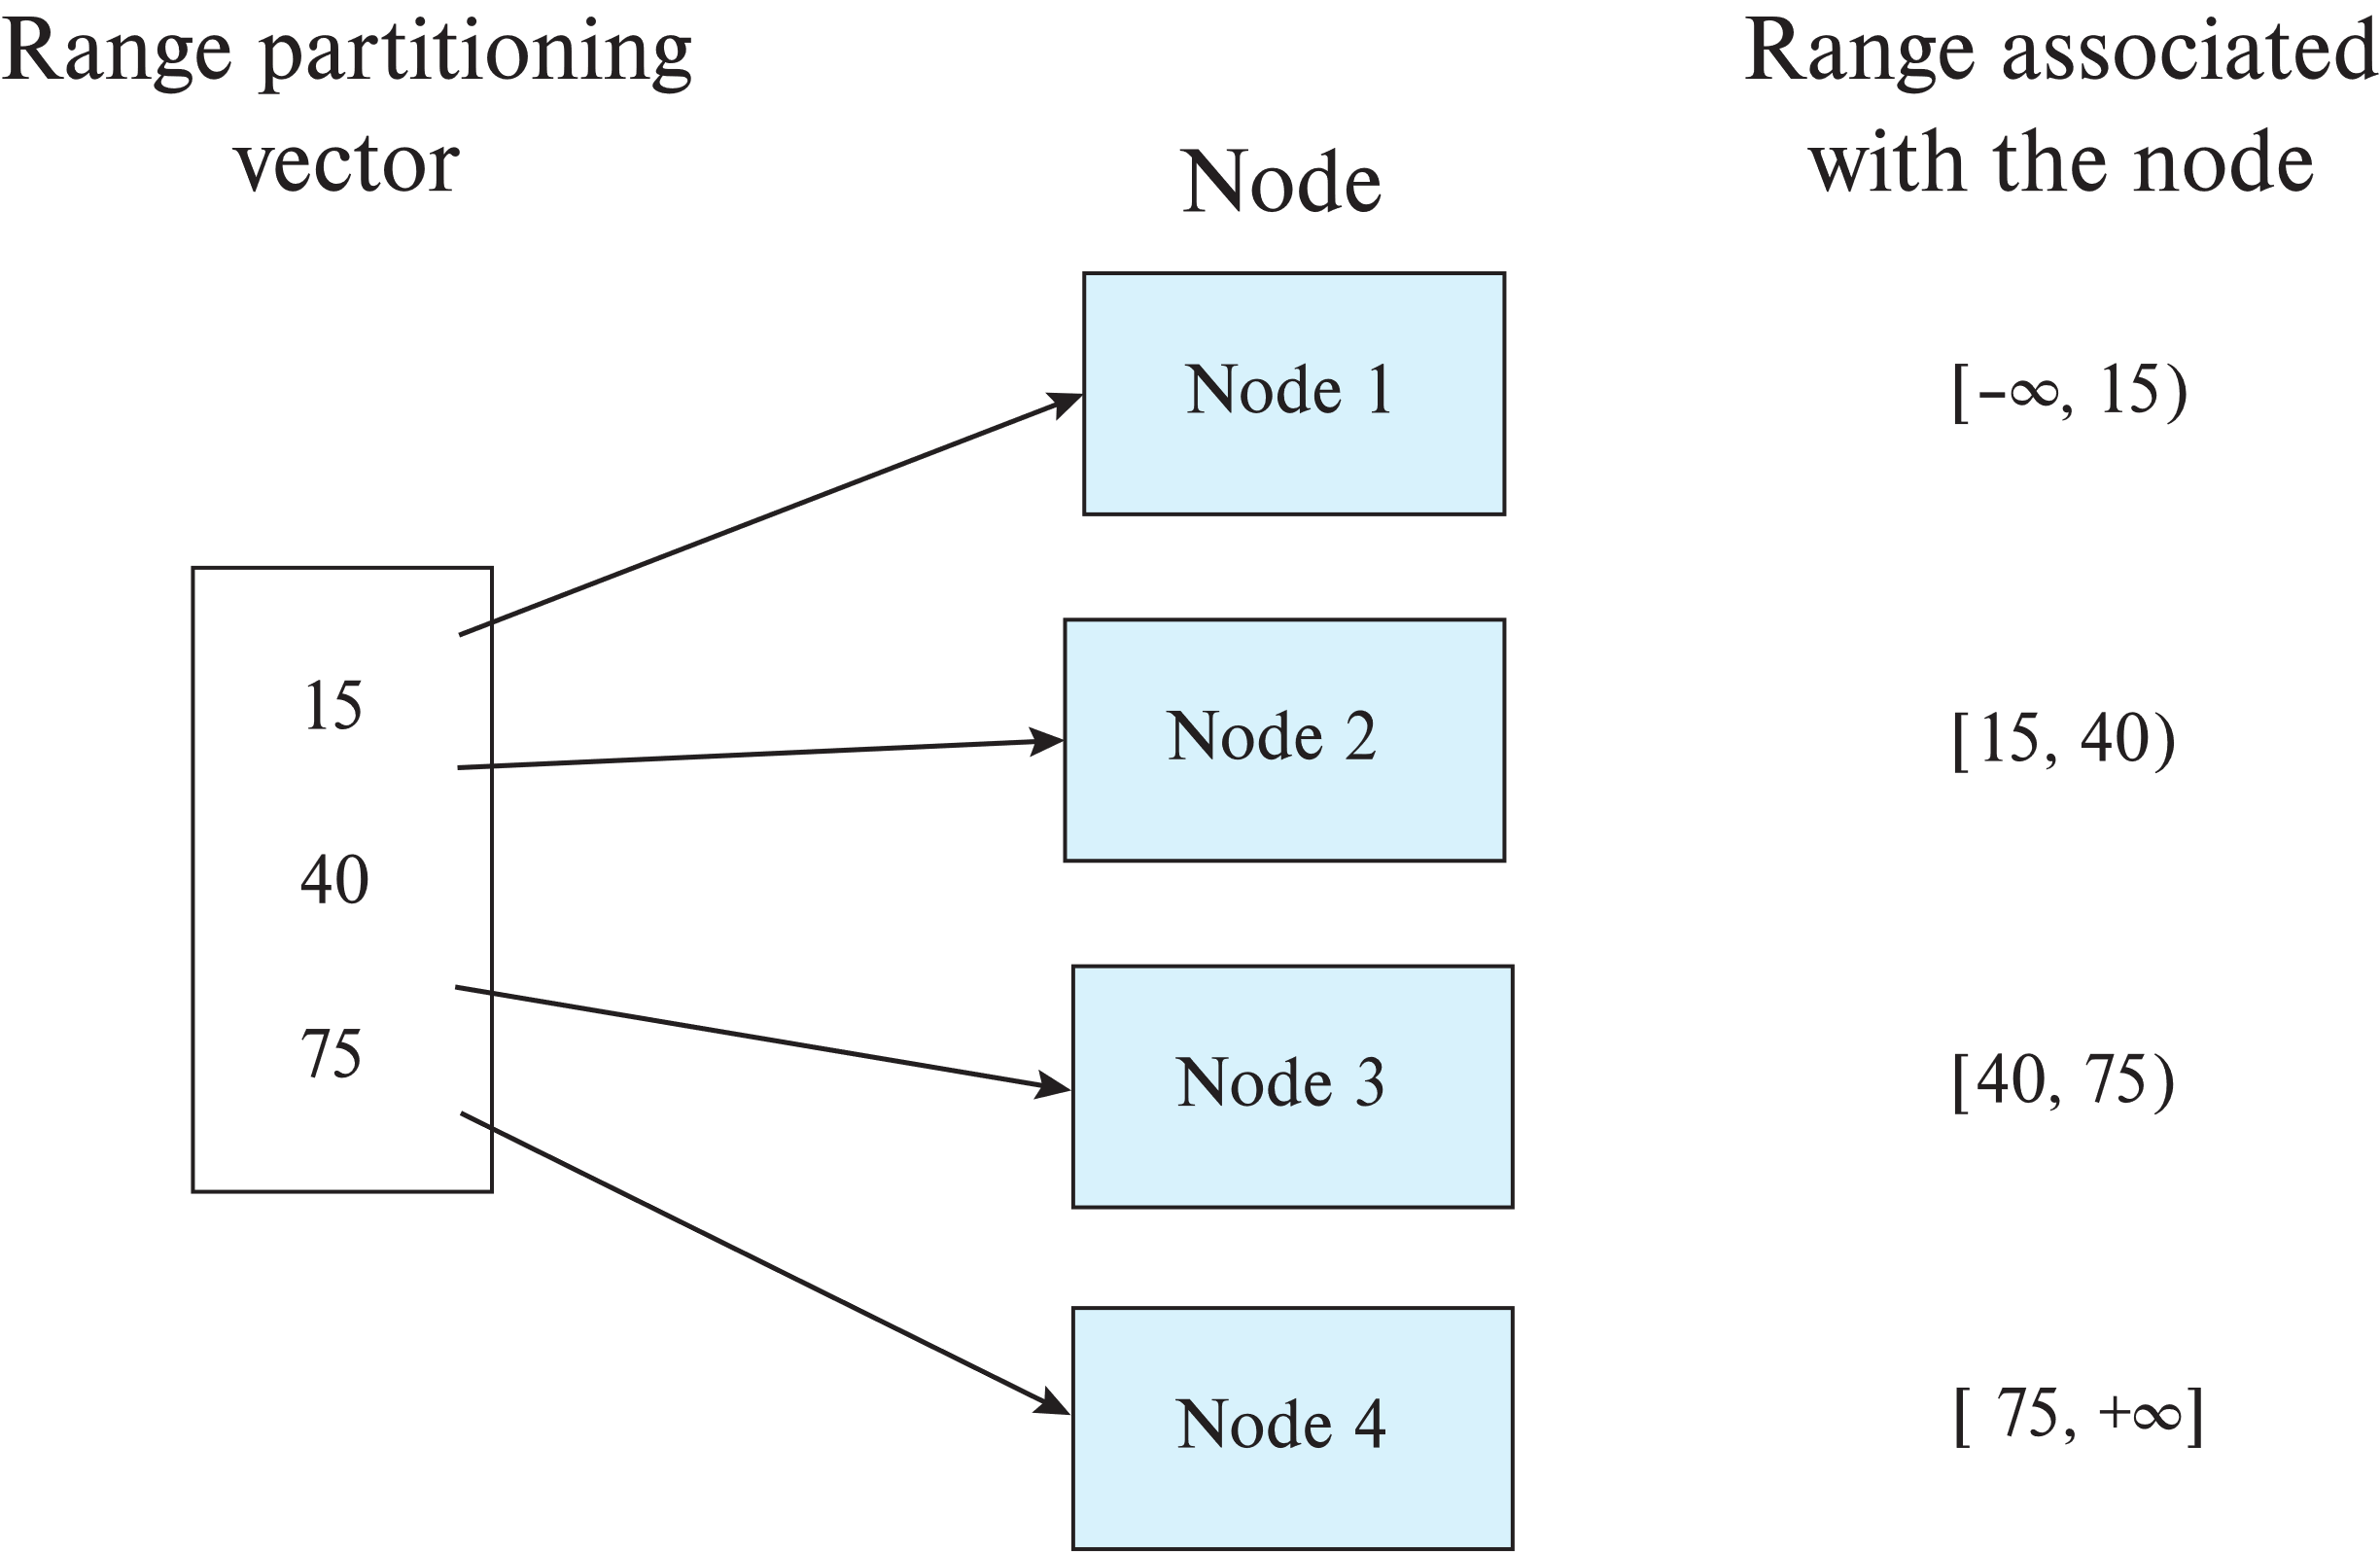
Range Partitioning

Slide 8
Storage Parallelism (Cont.)
Partitioning techniques (cont.):
Range partitioning:
Choose an attribute as the partitioning attribute.
A partitioning vector [v_{o}, v₁, ..., v_{n-2}] is chosen.
Let v be the partitioning attribute value of a tuple. Tuples such that v_{i} ≤ v_{i+1} go to node I + 1. Tuples with v < v₀ go to node 0 and tuples with v ≥ v_{n-2} go to node n-1.
E.g., with a partitioning vector [5,11]
a tuple with partitioning attribute value of 2 will go to node 0,
a tuple with value 8 will go to node 1, while
a tuple with value 20 will go to node2.

Slide 9
Comparison of Partitioning Techniques
Evaluate how well partitioning techniques support the following types of data access:
1. Scanning the entire relation.
2. Locating a tuple associatively – point queries.
E.g., r.A = 25.
3. Locating all tuples such that the value of a given attribute
lies within a specified range – range queries.
E.g., 10 ≤ r.A < 25.
Do above evaluation for each of
Round robin
Hash partitioning
Range partitioning

Slide 10
Comparison of Partitioning Techniques
Round robin:
Best suited for sequential scan of entire relation on each query.
All nodes have almost an equal number of tuples; retrieval work is thus well balanced between nodes.
Disadvantage: all queries involving multiple tuples must be processed at all nodes
Hash partitioning:
Similar to round robin: good for sequential access
Assuming hash function is good, and partitioning attributes form a key, tuples will be equally distributed between nodes
Less evenly distributed than round robin (uniform random is not the same as round robin)
Disadvantage: all queries involving multiple tuples must be processed at all nodes

Slide 11
Comparison of Partitioning Techniques
Range partitioning:
Provides data clustering by partitioning attribute value.
Good for sequential access
Good for point queries on partitioning attribute: only one node needs to be accessed.
For range queries on partitioning attribute, one to a few nodes may need to be accessed
Remaining nodes are available for other queries.
Good if result tuples are from one to a few blocks.
But if many blocks are to be fetched, they are still fetched from one to a few nodes, and potential parallelism in disk access is wasted
Example of execution skew.

Slide 12
Handling Small Relations
Partitioning not useful for small relations which fit into a single disk block or a small number of disk blocks
Instead, assign the relation to a single node, or
Replicate relation at all nodes
For medium sized relations, choose how many nodes to partition across based on size of relation
Large relations typically partitioned across all available nodes.

Slide 13
Types of Skew
Data-distribution skew: some nodes have many tuples, while others may have fewer tuples. Could occur due to
Attribute-value skew.
Some partitioning-attribute values appear in many tuples
All the tuples with the same value for the partitioning attribute end up in the same partition.
Can occur with range-partitioning and hash-partitioning.
Partition skew.
Imbalance, even without attribute –value skew
Badly chosen range-partition vector may assign too many tuples to some partitions and too few to others.
Less likely with hash-partitioning

Slide 14
Types of Skew (Cont.)
Note that execution skew can occur even without data distribution skew
E.g. relation range-partitioned on date, and most queries access tuples with recent dates
Data-distribution skew can be avoided with range-partitioning by creating balanced range-partitioning vectors

Slide 15
Lecture 8

Slide 16
Recap of lecture 7
Key-value store and database example (RocksDB + MyRocks)
Key-value stores
Much more limited interface than SQL (NoSQL)
Usually: get, put, update, delete, sometimes get_range, multiget
Often SQL/ACID databases are built on top of key-value stores
RocksDB
Writes always go to memory: buffer writes to flash
Data on disk is stored in immutable files
Log-structure merge tree data structure compacts files, removes stale data (old/deleted key-value pairs)
Uses bloom filters
Multi-level index: outer index for each level (sparse index, in levels 1-N have distinct and sorted key-ranges), inner and dense index for each file
MyRocks
Implements ACID + SQL on RocksDB
Uses lock table of RocksDB

Slide 17
Recap of lecture 7 (continued)
Partitioning
Partitioning trade off
More nodes involved in each query: execute queries faster
On the hand, requires more coordination, if one node fails can slow everything down
Round robin partitioning
Balances load
All nodes involved
Hash partitioning
Usually balances load
All nodes involved
Can be used in distributed settings (without a central coordinator)
Range partitioning
Can be skewed
Few nodes involved
Skew
Data skew
Data is not distributed evenly (e.g., using range partitioning on attribute, and certain values are more likely than others)
Execution skew
Certain data is accessed more frequently by a workload (e.g., certain rows are more “popular”/”hot”)

Slide 18
Today: Distributed systems
Centralized master model
Distributed file systems
Highlight: Hadoop File System (HDFS)
Distributed transactions and databases
Two phase commit
Improvements of two phase commit
If we have time:
MapReduce
Programming model
Dealing with failures
Spark intro

Slide 19
Logistics
Midterm
You still have time to take it until tomorrow at noon
Programming assignment #2
Should be available
Part 2 (streaming) is now optional
If you submit it, we will grade it, if not we won’t
Recommended if you can –- nice introduction to streaming

Slide 20
Master node

Slide 21
Routing of Queries
Partition table typically stored at a master node
Two alternative designs:
Queries are sent first to master, which forwards them to appropriate node
Disadvantage: need to communicate with master for each query
Master tells client (the node asking the query) which nodes stores which key range → clients directly communicate with data nodes
Advantage: do not need to talk to master for each query
Disadvantages: what happens if a node dies and client has old information? Scalability
Examples of systems that use a master node: Hadoop File System, Google File System, BigTable (precursor to BigQuery), HBase (open source version of BigTable)
Consistent hashing is an alternative fully-distributed scheme, without a master, uses a form of hash partitioning
Without any master nodes, works in a completely peer-to-peer fashion
Advantage: no single point of failure (master), scalability
Disadvantage: typically requires more communication/coordination among nodes
Examples of systems that use consistent hashing: Cassandra, DynamoDB

Slide 22
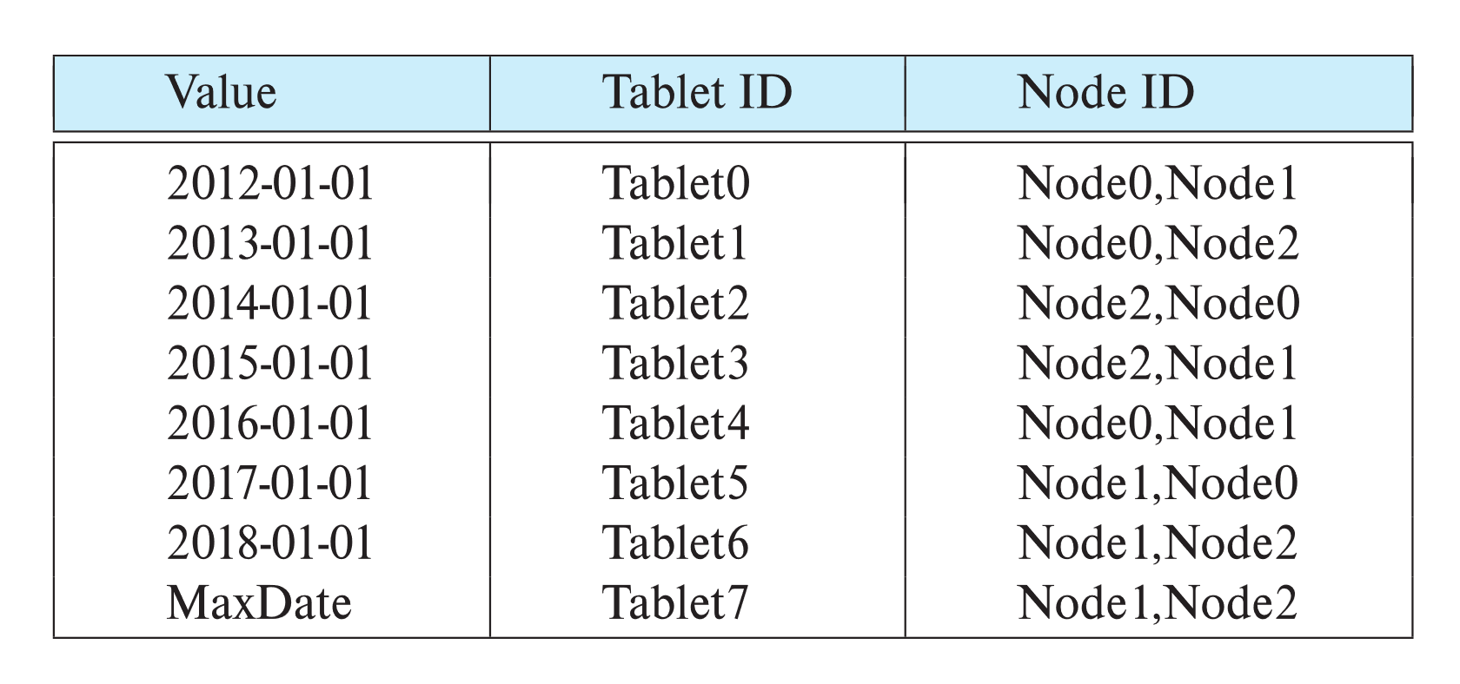
Replication
Goal: availability despite failures
Data replicated at 2, often 3 nodes
Why 3?
Unit of replication typically a partition (tablet)
Requests for data at failed node automatically routed to a replica
Partition table with each tablet replicated at two nodes

Slide 23
Basics: Data Replication
Location of replicas
Replication within a data center
Handles machine failures
Reduces latency if copy available locally on a machine
Replication within/across racks
Replication across data centers
Handles data center failures (power, fire, earthquake, ..), and network partitioning of an entire data center
Provides lower latency for end users if copy is available on nearby data center

Slide 24
Updates and Consistency of Replicas
Replicas must be kept consistent on update
Despite failures resulting in different replicas having different values (temporarily), reads must get the latest value.
Special concurrency control and atomic commit mechanisms to ensure consistency
Master replica (primary copy) scheme
All updates are sent to master, and then replicated to other nodes
Reads are performed at master
But what if master fails? Who takes over? How do other nodes know who is the new master?

Slide 25
Protocols to Update Replicas
Two-phase commit
Coming up!
Assumes all replicas are available
Consensus protocols
Protocol followed by a set of replicas to agree on what updates to perform in what order
Can work even without a designated master

Slide 26
Distributed File Systems

Slide 27
Distributed File Systems
Hadoop File System (HDFS)
Google File System (GFS)
And older ones like CODA
And more recent ones such as Google Colossus
Basic architecture:
Master: responsible for metadata
Chunk servers: responsible for reading and writing large chunks of data
Chunks replicated on 3 machines, master responsible for managing replicas
Replication is in GFS/HDFS is within a single data center

Slide 28
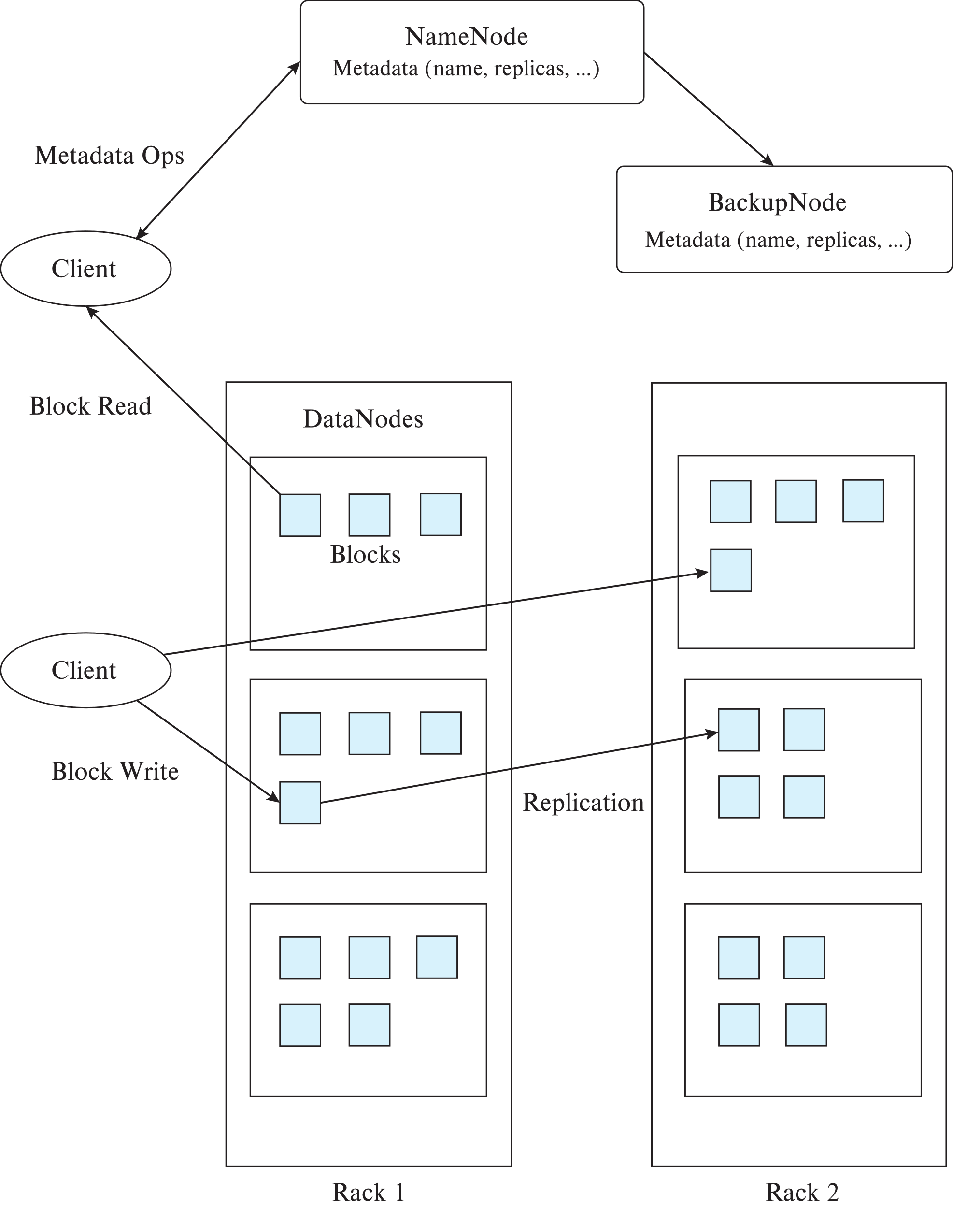
Hadoop File System (HDFS)
Client: sends filename to NameNode
NameNode (the master)
Maps a filename to list of Block IDs
Maps each Block ID to DataNodes containing a replica of the block
Returns list of BlockIDs along with locations of their replicas
DataNode:
Maps a Block ID to a physical location on disk
Sends data back to client

Slide 29
Hadoop Distributed File System
Hadoop Distributed File System (HDFS)
Modeled after Google File System (GFS)
Single Namespace (e.g., single directory structure) for entire cluster
Data model
Write-once-read-many access model
Client can only append to existing files
Files are broken up into blocks
Typically 64 MB block size
Each block replicated on multiple (e.g., 3) DataNodes
Client
Finds location of blocks from NameNode
Accesses data directly from DataNode
NameNode is not on the critical path of reads and writes

Slide 30
Limitations of HDFS
Central master becomes bottleneck
Keep directory information in memory to avoid expensive storage reads/writes
Memory size limits number of files
What happens if it fails?
File system directory overheads per file
Not appropriate for storing very large number of objects
File systems do not provide consistency guarantees
File systems cache blocks locally
Ideal for write-once and append only data
Can be used as underlying storage for a data storage system
E.g., BigQuery/BigTable uses GFS/Colossus underneath, Hbase/Spark uses HDFS underneath

Slide 31
Distributed File Systems vs. Databases
Distributed data storage implementations:
May have limited support for relational model (no schema, or flexible schema)
But usually do provide flexible schema and other features
Structured objects e.g. using JSON
Multiple versions of data items
Often provide no support or limited support for transactions
But some do!
Provide only lowest layer (similar to the file system layer)
Often have KV store on top of them, and relational DB on top of the KV store

Slide 32
Geographically Distributed Storage
Many storage systems today support geographical distribution of storage
Motivations: Fault tolerance, latency (close to user), governmental regulations
Latency of replication across geographically distributed data centers much higher than within data center
Some key-value stores support synchronous replication
Must wait for replicas to be updated before committing an update
Others support asynchronous replication
update is committed in one data center, but sent subsequently (in a fault-tolerant way) to remote data centers
Must deal with small risk of data loss if data center fails.

Slide 33
Distributed Databases and Transactions

Slide 34
Approach 1: Sharding (AKA “shared-nothing” architecture)
Divide data amongst many cheap databases (MySQL/MyRocks/PostgreSQL)
Manage parallel access in the application
Partition tables map keys to nodes
Application decides where to route storage or lookup requests
Scales well for both reads and writes: used widely in data center settings
Limitations
Not transparent
application needs to be partition-aware
AND application needs to deal with replication
(Not a true parallel database, since parallel queries and transactions spanning nodes are not supported)

Slide 35
Approach 2: Distributed Transactions
Local transactions
Access/update data at only one database
Global transactions
Access/update data at more than one database
Key issue: how to ensure ACID properties for transactions in a system with global transactions spanning multiple database

Slide 36
Distributed Transactions
Transaction may access data at several sites.
Each site has a local transaction manager
Each site has a transaction coordinator
Global transactions submitted to any transaction coordinator

Slide 37
Distributed Transactions
Each transaction coordinator is responsible for:
Starting the execution of transactions that originate at the site.
Distributing subtransactions at appropriate sites for execution.
Coordinating the termination of each transaction that originates at the site
Transaction must be committed at all sites or aborted at all sites.
Each local transaction manager responsible for:
Maintaining a log for recovery purposes for the node it belongs to
Coordinating the execution and commit/abort of the transactions executing at that site.

Slide 38
System Failure Modes
Failures unique to distributed systems:
Failure of a site
Loss of messages
Handled by networking protocols such as TCP-IP
Network partition
A network is said to be partitioned when it has been split into two or more subsystems that lack any connection between them
Note: a subsystem may consist of a single node
Network partitioning and site failures are generally indistinguishable.

Slide 39
Commit Protocols
Commit protocols are used to ensure atomicity across sites
A transaction which executes at multiple sites must either be committed at all the sites, or aborted at all the sites.
Cannot have transaction committed at one site and aborted at another
Why?
The two-phase commit (2PC) protocol is widely used
Consensus protocols solve a more general problem, but can be used for atomic commit
We assume fail-stop model – failed sites simply stop working, and do not cause any other harm, such as sending incorrect messages to other sites (they do not become “malicious”)
This is the assumption in many distributed systems, but not all
For example, Blockchains assume that each node can be malicious (Byzantine failure model)
Generally a reasonable assumption when all the nodes reside under the same organization, with no conflicting interests

Slide 40
Two Phase Commit Protocol (2PC)
Execution of the protocol is initiated by any coordinator.
The protocol involves all the local sites at which the transaction executed
Protocol has two phases
Let T be a transaction initiated at site S_{i}, and let the transaction coordinator at S_{i} be C_{i}

Slide 41
Phase 1: Obtaining a Decision
Coordinator asks all participants to prepare to commit transaction T_{i}.
C_{i} adds the records <prepare T> to the log and forces log to stable storage
sends prepare T messages to all sites at which T executed
Upon receiving message, transaction manager at site determines if it can commit the transaction
if not, add a record <no T> to the log and send abort T message to C_{i}
if the transaction can be committed, then:
add the record <ready T> to the log
force all records for T to stable storage (i.e., execute the transaction locally)
send ready T message to C_{i}
Transaction is now in ready state at the site

Slide 42
Phase 2: Recording the Decision
T can be committed if C_{i} received a ready T message from all the participating sites: otherwise T must be aborted.
Coordinator adds a decision record, <commit T> or <abort T>, to the log and forces record onto stable storage. Once the record is in stable storage it is irrevocable (even if failures occur)
Coordinator sends a message to each participant informing it of the decision (commit or abort)
Participants take appropriate action locally.
If the transaction was committed, they can commit locally
If it was aborted, they need to undo the transaction based on their local logs

Slide 43
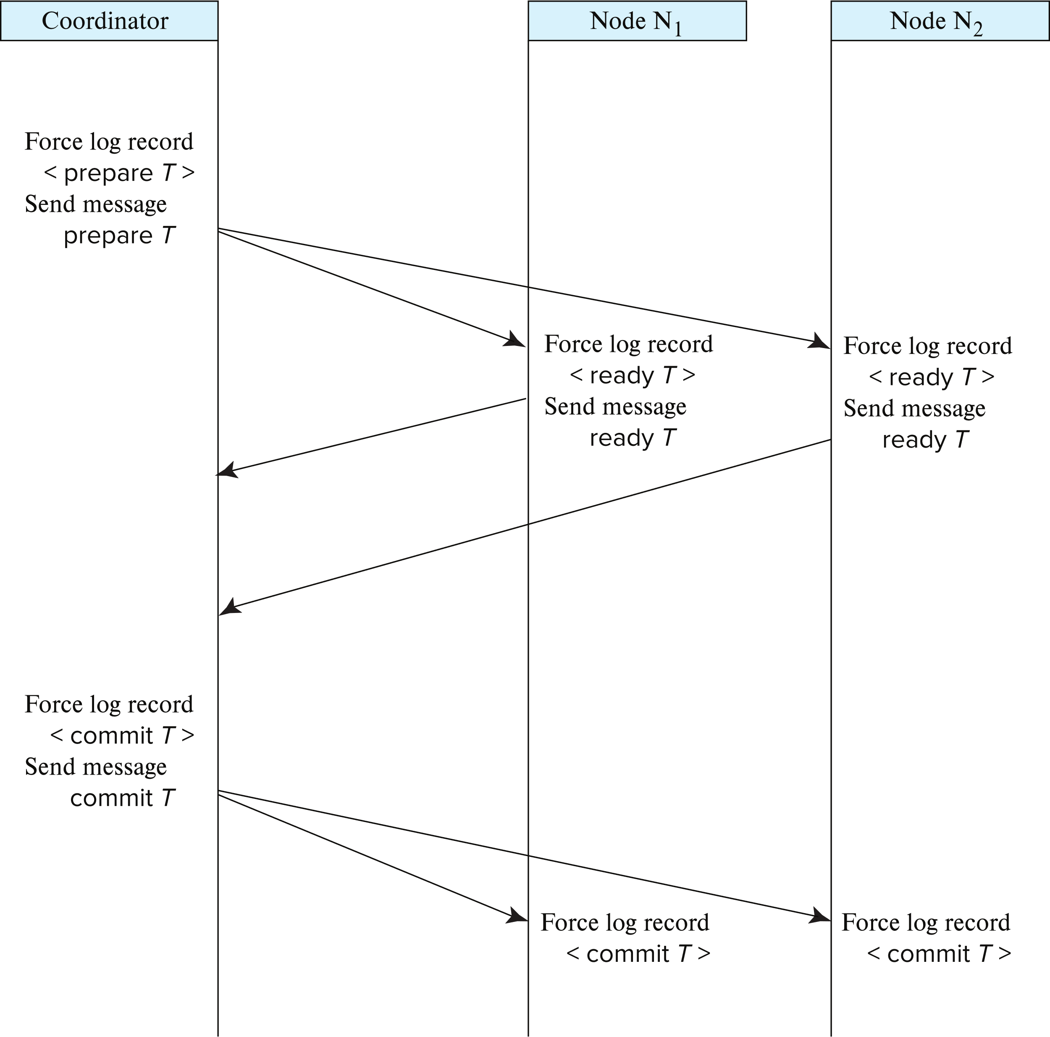
Two-Phase Commit Protocol

Slide 44
Handling of Failures - Site Failure
When site S_{k} recovers, it examines its log to determine the fate of transactions active at the time of the failure.
Log contain <commit T> record: site executes redo (T)
Uses the WAL
Log contains <abort T> record: site executes undo (T)
Uses the WAL
Log contains <ready T> record: site must consult C_{i} to determine the fate of T.
If T committed, redo (T)
If T aborted, undo (T)
The log contains no control records concerning T implies that S_{k} failed before responding to the prepare T message from C_{i}
since the failure of S_{k} precludes the sending of such a response C_{i} must abort T
S_{k} must execute undo (T)

Slide 45
Handling of Failures- Coordinator Failure
If coordinator fails while the commit protocol for T is executing then participating sites must decide on T’s fate:
If an active site contains a <commit T> record in its log, then T must be committed.
If an active site contains an <abort T> record in its log, then T must be aborted.
If some active participating site does not contain a <ready T> record in its log, then the failed coordinator C_{i} cannot have decided to commit T. Can therefore abort T.
If none of the above cases holds, then all active sites must have a <ready T> record in their logs, but no additional control records (such as <abort T> of <commit T>). In this case active sites must wait for C_{i} to recover, to find decision.
Blocking problem: active sites may have to wait for failed coordinator to recover.

Slide 46
Handling of Failures - Network Partition
If the coordinator and all its participants remain in one partition, the failure has no effect on the commit protocol.
If the coordinator and its participants belong to several partitions:
Sites that are not in the partition containing the coordinator think the coordinator has failed, and execute the protocol to deal with failure of the coordinator.
No harm results, but sites may still have to wait for decision from coordinator.
The coordinator and the sites are in the same partition as the coordinator think that the sites in the other partition have failed, and follow the usual commit protocol.
Again, no harm results
Notes:
If there are several partitions, they need to wait for the partition to resolve before making a decision

Slide 47
Recovery and Concurrency Control
In-doubt transactions have a <ready T>, but neither a <commit T>, nor an <abort T> log record.
The recovering site must determine the commit-abort status of such transactions by contacting other sites; this can slow and potentially block recovery.
Recovery algorithms can note lock information in the log.
Instead of <ready T>, write out <ready T, L>
L = list of locks held by T when the log is written (read locks can be omitted).
For every in-doubt transaction T, all the locks noted in the <ready T, L> log record are reacquired.
After lock reacquisition, transaction processing can resume; the commit or rollback of in-doubt transactions is performed concurrently with the execution of new transactions.

Slide 48
Avoiding Blocking During Consensus
Blocking problem of 2PC is a serious concern
Any participant that fails or is delayed will block all other nodes!
Idea: involve multiple nodes in decision process, so failure of a few nodes does not cause blocking as long as majority don’t fail
More general form: distributed consensus problem
A set of n nodes need to agree on a decision
Inputs to make the decision are provided to all the nodes, and then each node votes on the decision
The decision should be made in such a way that all nodes will “learn” the same value for the even if some nodes fail during the execution of the protocol, or there are network partitions.
Further, the distributed consensus protocol should not block, as long as a majority of the nodes participating remain alive and can communicate with each other
Several consensus protocols, Paxos and Raft are popular
Notes:
Consensus requires majority, whereas 2PC requires all nodes

Slide 49
Using Consensus to Avoid Blocking
After getting response from 2PC participants, coordinator can initiate distributed consensus protocol by sending its decision to a set of participants who then use consensus protocol to commit the decision
If coordinator fails before informing all consensus participants
Choose a new coordinator, which follows 2PC protocol for failed coordinator
If a commit/abort decision was made as long as a majority of consensus participants are accessible, decision can be found without blocking
If consensus process fails (e.g., split vote), restart the consensus
Split vote can happen if a coordinator send decision to some participants and then fails, and new coordinator send a different decision
The three phase commit protocol is an extension of 3PC which avoids blocking under certain assumptions
Ideas are similar to distributed consensus.
Consensus is also used to ensure consistency of replicas of a data item
For example, can be used to protect against failure of master nodes (e.g., the NameNode in HDFS)

